Slide 1
Churn Analysis
Team 9
Nitin Wahie, Anunay Gupta, Shiva Kumar Pabbathi, Zheming Lian, Manikanta Chinta

Slide 2
“Don't Spend 5 Times More Attracting New Customers, Nurture The Existing Ones” - Forbes

Slide 3

Problem statement
What factors can the company influence to reduce churn of customers?
Why does it matter?
Understanding the factors will help the company in having an edge over competitors and help is retaining customers ensuring growth.

Slide 4
Dataset
Customer data for a telecom company providing home phone and Internet services to 7,043 customers in California during Q3, 2009
Source: Kaggle
Important features:
Demographic: Gender, Senior Citizen, Partnered, Dependents
Services: Tenure in Months, Online Backup Plan, Online Security, Streaming TV, Paperless Billing, Device Protection Plan, Premium Tech Support (Treatment)
Status: Churn Label (Outcome variable)
Other than Tenure in Months, all other attributes are binary variables

Slide 5
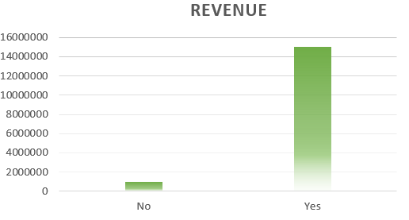
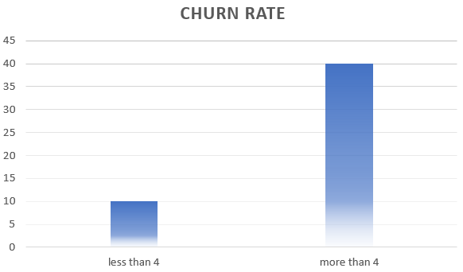
Scope of analysis
Customers who subscribed to Internet Service because this is the major division in terms of revenue.
Customers who stayed with us for less than 4 years because we are seeing very high churn among these compared to customers who are with us for more than 4 years.

Slide 6
Conclusion of analysis
Getting customers enrolled in premium technical support program makes them less likely to churn out
Getting customers enrolled in paperless billing makes them more likely to churn out.

Slide 7
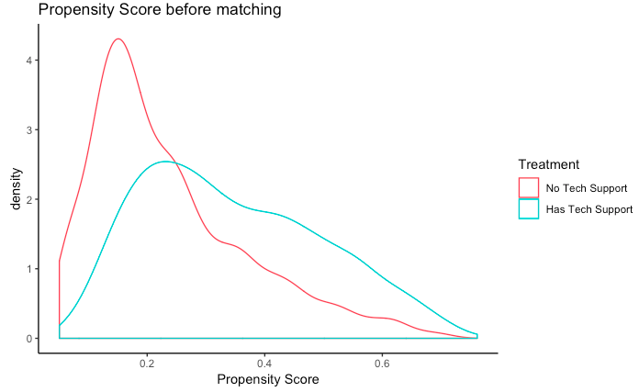
Covariate Imbalance detected by visualization and statistical test
Imbalanced covariates*:
10 out of 11 attributes fail to pass randomization test.
* The corresponding statistical tests (t-test/chisq test) returns a p-values < 0.05.

Slide 8
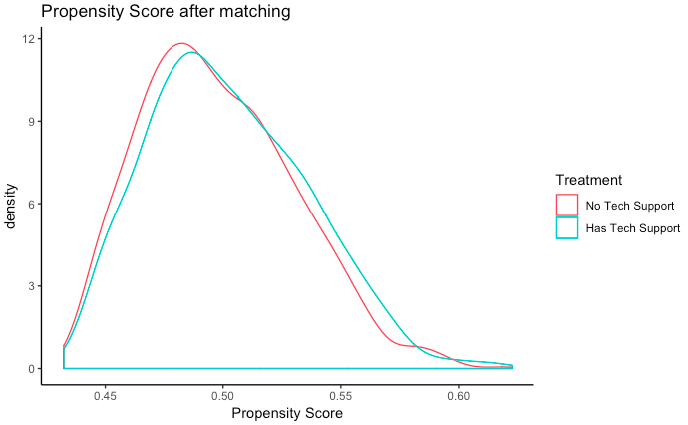
Matching using propensity score approach and its result
I
Parameters: calibre = 0.01, replace = False
All statistical tests return insignificant results. (p-values are at least 0.11)
After matching, # of samples in each group is 987.
Compared with 1855 samples in each group before matching.

Slide 9
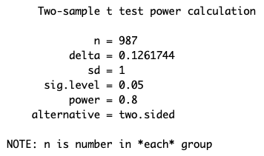
Power test: true difference (delta) that can be detected
Given 0.05 Type I error, 0.8 power, and 987 sample in each group, we can detect a true difference as large as 0.126 log odds.

Slide 10
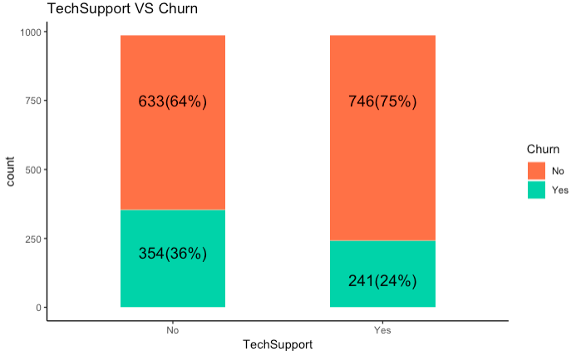
Visualization

Slide 11
Causal inference using logistic regression
Model:
Target variable: Churn out
Treatment: TechSupport
Confounders: demographic and services variables
Main Insight:
Getting customer into Technical Support Plan decreases the churn out probability. (a decrease in log odds by 0.62)
Byproduct of experiment:
Getting customer into paperless billing / Make customers watch Streaming TV may increase the churn out probability.

Slide 12
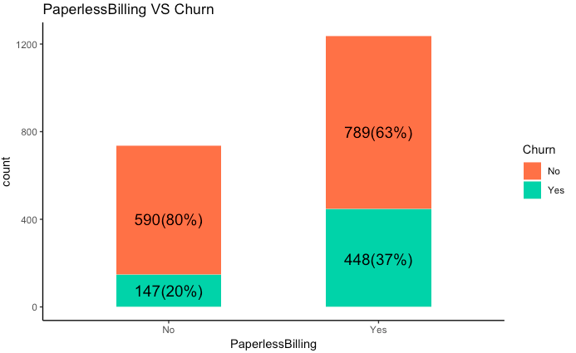
Visualization 2

Slide 13
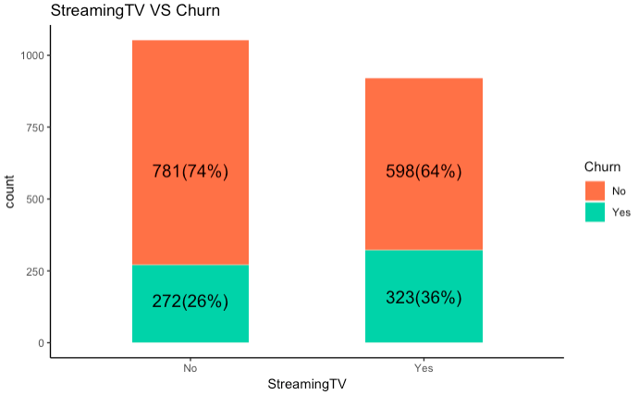
Visualization 3

Slide 14
Recommendation
Promote Technical support plan to customers
Make another experiment for paperless billing to investigate how does it affect the churn out. If the experiment is significant, then we need to look into it.

Slide 15
Limitations
There can be some confounding variables which are missing from the data.
Assumption of Urban vs Rural behaviour is absent and people of similar age groups and other characteristics behave similarly in both urban and rural areas wrt telecom usage.
Limitation of Matching: One treatment group must be selected and the control group is then matched to that group.The treatment effect then represents an estimate for the selected group only, not the full population.

Slide 16
Thank You

Slide 17
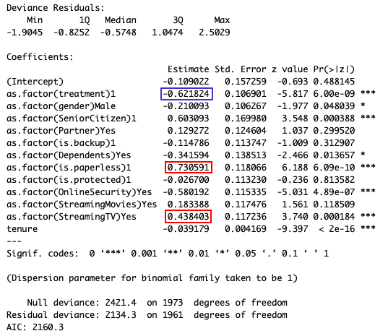
Appendix

